Slide 1

Exploratory Data Analysis
G2M insight for Cab Investment firm
Sept/17/2023

Slide 2
Agenda
Introduction
Dataset Overview
Assumptions & Constraints
Profit Analysis
Payment mode Analysis
Market Share Analysis
Customer Retention Analysis
Customer and ride analysis
Hypothesis
Conclusion

Slide 3
Introduction
Client Overview: XYZ, a leading private firm in the US, is exploring investment opportunities in the rapidly growing Cab Industry. With multiple key players in the market, XYZ aims to make informed decisions as part of its Go-to-Market (G2M) strategy.
Project Scope: This project involves a comprehensive analysis of data sets representing two prominent cab companies. These data sets offer insights into various aspects of customer profiles.
Objective: The primary goal of our analysis is to provide actionable insights that will assist XYZ's Executive team in selecting the most suitable cab company for their investment.
Project Outcome: Our findings will be presented to XYZ's Executive team, focusing on the quality of analysis, the value of recommendations, and the clarity of insights.

Slide 4
Dataset Overview
Dataset Information:
Cab Data: This dataset contains information about cab rides and includes details like the transaction ID, date of travel, company, city, kilometers traveled, price charged, cost of the trip, and state.
City Data: This dataset contains information about various cities, including their population, number of users, city name, and state.
Customer Data: This dataset contains information about customers, including customer ID, gender, age, and income (USD/month).
Transaction Data: This dataset includes information about transactions, including the transaction ID, customer ID, and payment mode.
Timeframe:
Time period of data is from 31/01/2016 to 31/12/2018.
Total Data Points:
State the total number of records in the dataset: 359392
Cab_Data.csv
Customer_ID.csv
Transaction_ID.csv
City.csv
Final cab data

Slide 5
Assumptions & Constraints
Assumptions:
Constraints:
Data Quality: It's assumed that the provided datasets are accurate and reliable. Any errors or inconsistencies in the data could affect the analysis.
Data Completeness: It's assumed that the provided datasets contain all the relevant information needed for the analysis. Missing data or incomplete records may require handling.
Outliers: It's assumed that outliers in certain features, such as "Price Charged," are present but are not treated as errors. The impact of outliers on the analysis is considered.
Derived Features: Assumptions may have been made when creating derived features or calculations, such as profit calculations.
User Attribution: The assumption that the "Users" feature in the "City Data" represents the number of cab users in the city, including users of both Yellow and Pink cabs.
Data Availability: The analysis is constrained by the availability of data. If certain data points or information are missing, it may limit the depth of the analysis.
Scope: The project scope may be limited to the provided datasets. Additional external data sources may not be available for validation or enhancement.
Timeframe: The analysis is conducted within a specific timeframe (e.g., data from 2016-01-31 to 2018-12-31). Trends and insights may be limited to this timeframe.
Cost Data: Due to the unavailability of trip duration details, the analysis does not treat the "Price Charged" outliers as errors.
Profit Calculation: Profit calculations are made while keeping other factors constant, focusing solely on "Price Charged" and "Cost of Trip."
User Attribution: The assumption that the "Users" feature in the "City Data" represents the number of cab users in the city may have limitations, as it may include users of other cab companies.

Slide 6
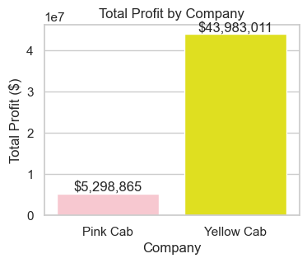
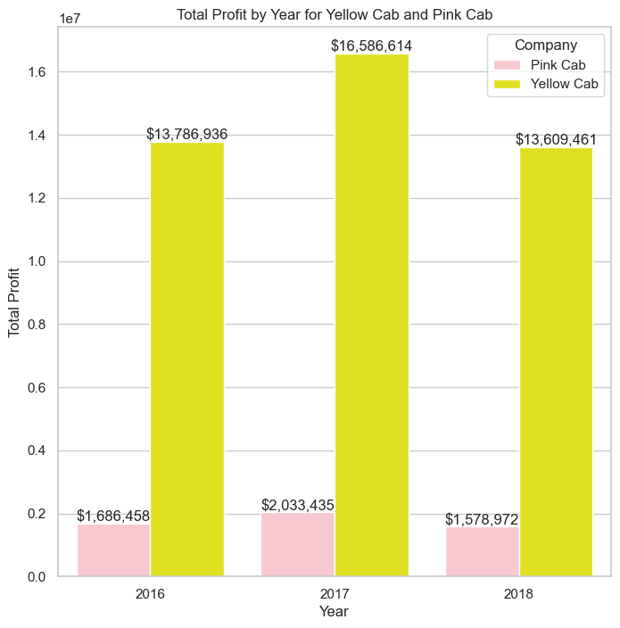
Profit Analysis
Total profit for yellow cabs is higher than total profit for pink cabs.
Yellow Cab has a higher total profit than Pink Cab in every year.
The difference in total profit between Yellow Cab and Pink Cab has been increasing over time.

Slide 7
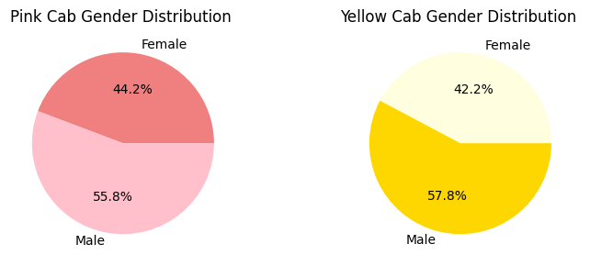
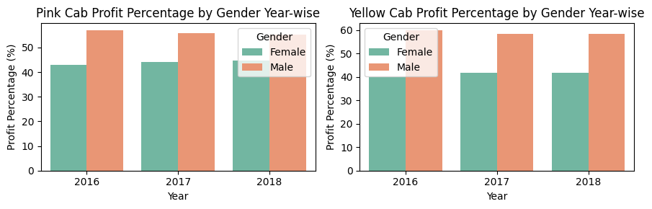
Profit Analysis
The difference in the percentage of female and male customers is greater for Pink Cab than for Yellow Cab.
The profit percentage for female customers is higher for Pink Cab than for Yellow Cab.
The profit percentage for male customers is higher for Yellow Cab than for Pink Cab.
The difference in profit percentage between male and female customers is greater for Pink Cab than for Yellow Cab.
The profit percentage for both companies has been increasing over time, but the rate of growth has been higher for Pink Cab.

Slide 8
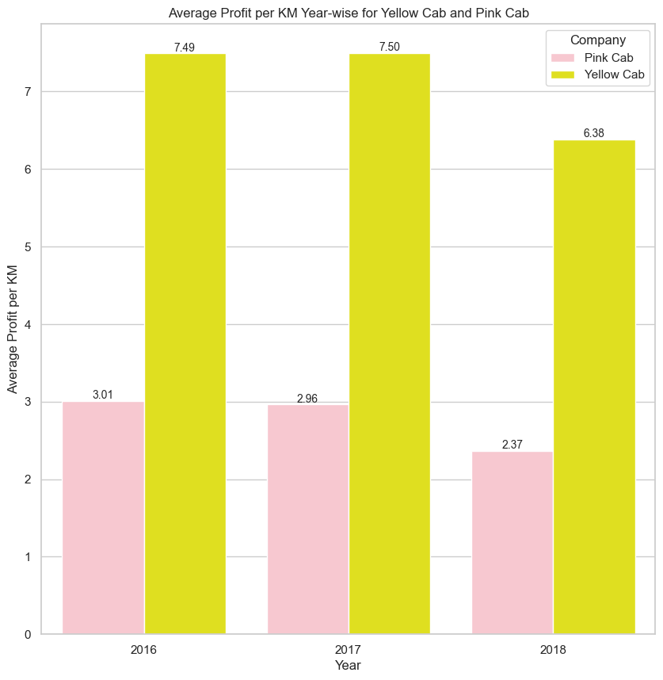
Profit Analysis
Yellow Cab has a higher average profit per KM than Pink Cab in all years.
Pink cab average profit per KM is decreasing year on year

Slide 9
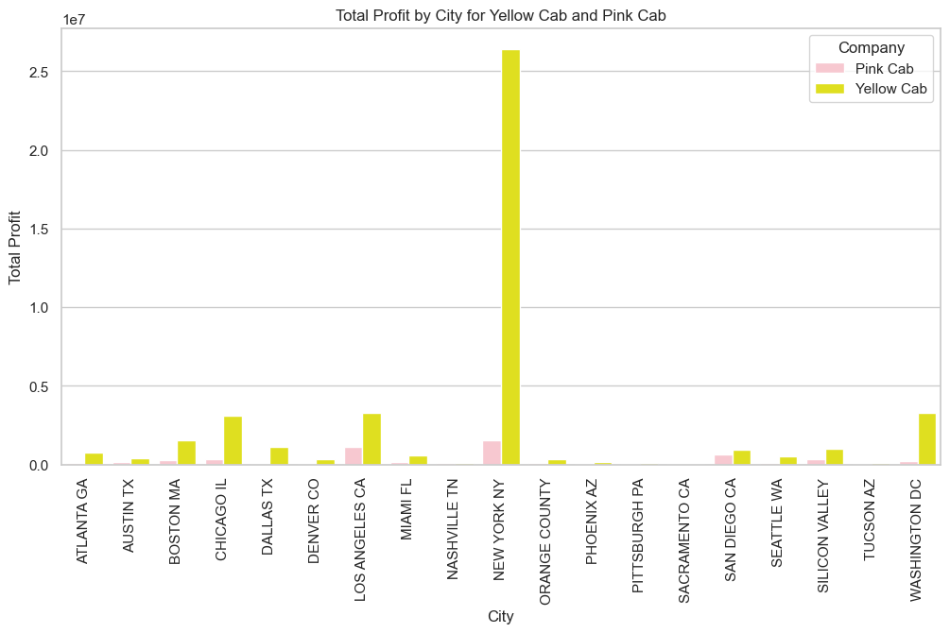
Profit Analysis
This suggests that Yellow Cab is more profitable than Pink Cab in all cities, but the difference in profitability is greatest in major metropolitan areas.

Slide 10
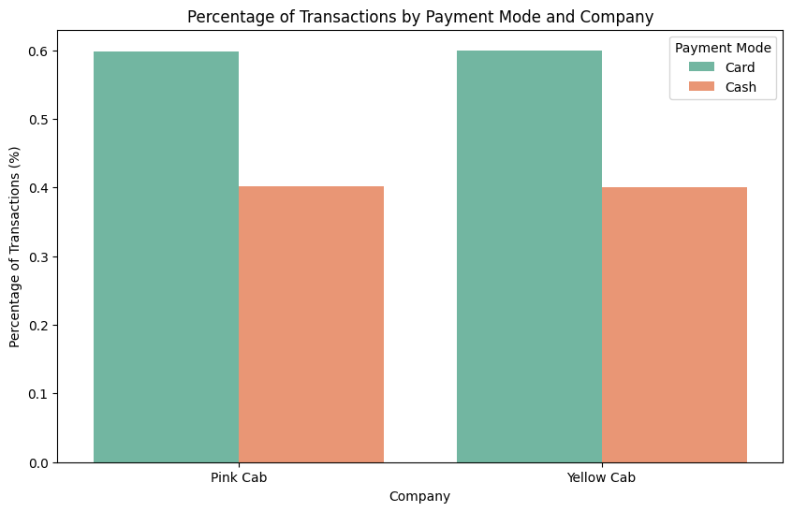
Payment mode Analysis
Card is the most popular payment mode for both Yellow Cab and Pink Cab, followed by cash.

Slide 11
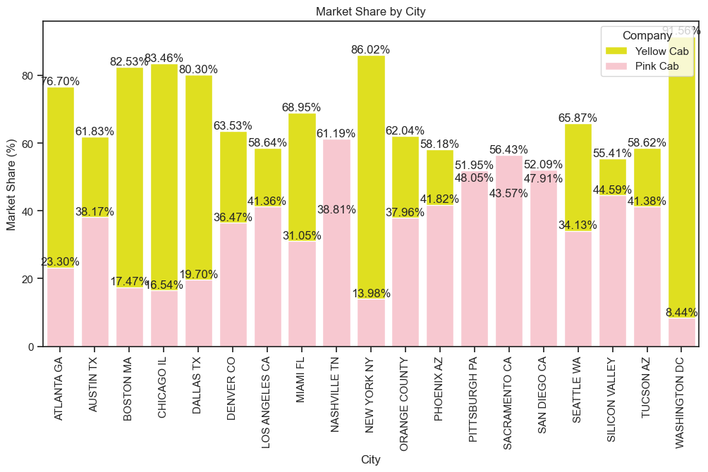
Market Share Analysis
Market share distribution: Yellow Cab has a higher market share than Pink Cab in all cities except for San Diego and Tucson.
Market share concentration: The market share of the top two companies is highest in New York City and Los Angeles, and lowest in Tucson and Pittsburgh.

Slide 12
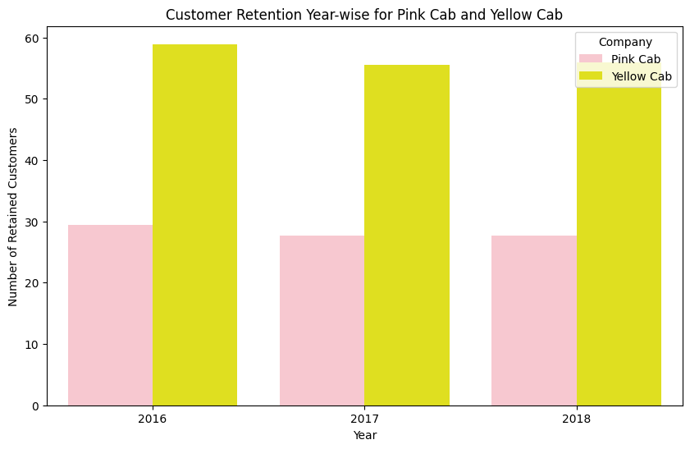
Market Share Analysis
Project Scope: This project involves a comprehensive analysis of data sets representing two prominent cab companies. These data sets offer insights into various aspects of customer profiles.
Objective: The primary goal of our analysis is to provide actionable insights that will assist XYZ's Executive team in selecting the most suitable cab company for their investment.
Project Outcome: Our findings will be presented to XYZ's Executive team, focusing on the quality of analysis, the value of recommendations, and the clarity of insights.

Slide 13
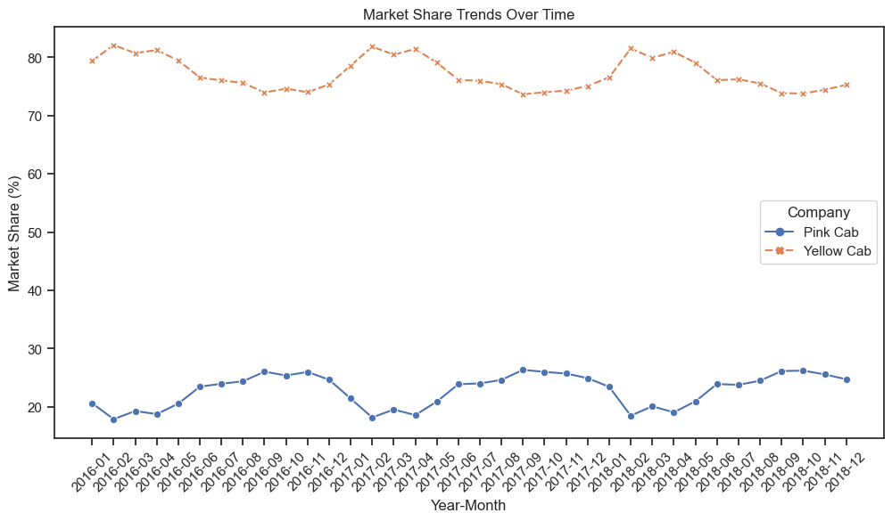
Market Share Analysis
Yellow Cab is now the dominant player in the taxi industry, with a market share around 60%.
Pink Cab is a much smaller player in the taxi industry, with a market share of less than 25%.

Slide 14
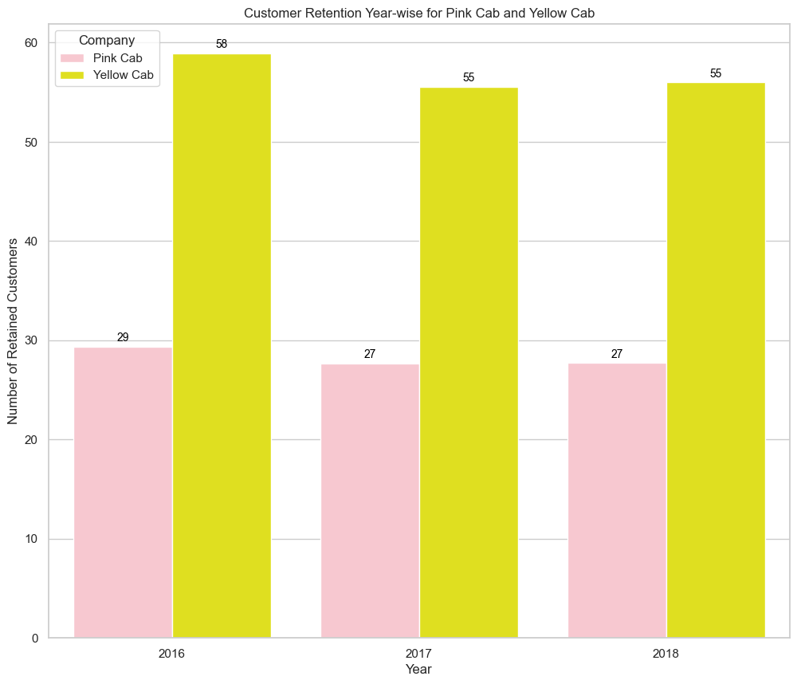
Customer Retention Analysis
Yellow Cab has a higher customer retention rate than Pink Cab in all years.
The customer retention rate for both companies has been declining over time. However, the decline has been more pronounced for Pink Cab.
The gap between Yellow Cab's customer retention rate and Pink Cab's customer retention rate has been widening over time.

Slide 15
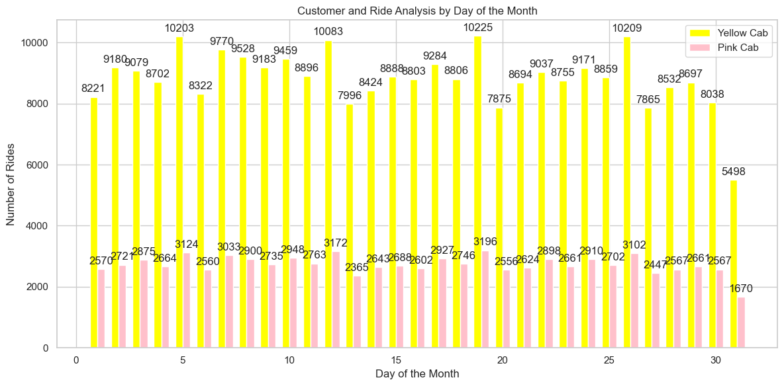
Customer and ride analysis
Overall, the number of rides is highest in the middle of the month and lowest at the beginning and end of the month. This is likely due to the fact that people are more likely to have money to spend on taxis in the middle of the month, after they have been paid.
Yellow Cab has a higher number of rides than Pink Cab on all days of the month. This suggests that Yellow Cab is the more popular taxi company overall.

Slide 16
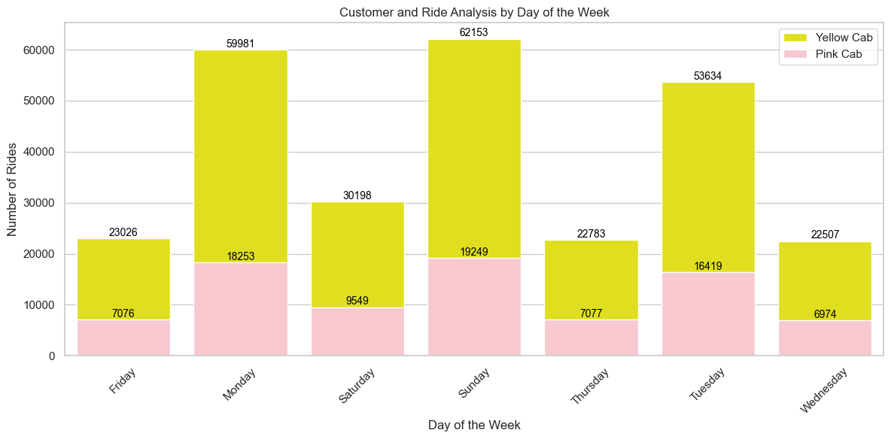
Customer and ride analysis
Overall, the number of rides is highest on Sunday and lowest on Wednesday.
Yellow Cab has a higher number of rides than Pink Cab on all days of the week. This suggests that Yellow Cab is the more popular taxi company overall.

Slide 17
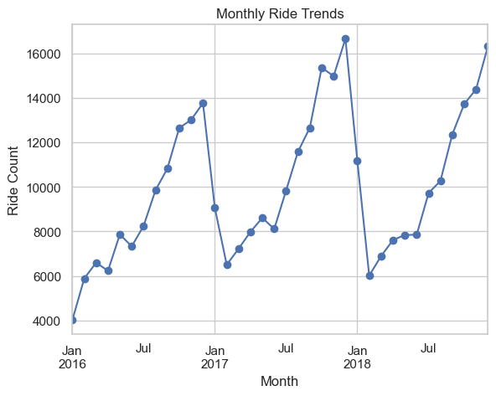
Hypothesis 1: Seasonality in customer usage
Seasonality in Customer Usage
The graph shows that the number of cab users is higher in the summer months (Jun-Aug) and lower in the winter months (Dec-Feb).
This suggests that there may be a seasonal trend in the number of cab users.

Slide 18
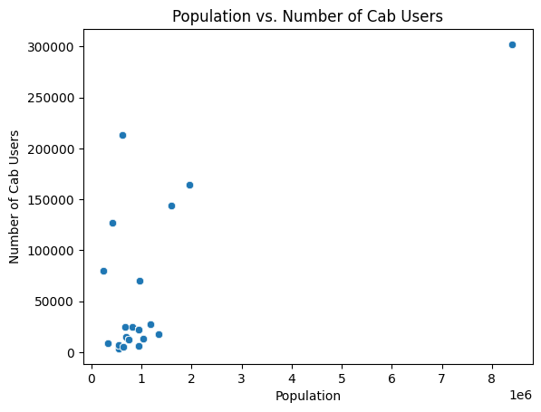
Hypothesis 2: How does population size correlate with the number of cab users?"
The scatter plot shows a positive correlation between population size and the number of cab users. This means that as the population size increases, the number of cab users also tends to increase.
This is likely due to the fact that larger cities have more people who need to get around, and they also have more businesses and establishments that generate demand for taxi services.

Slide 19
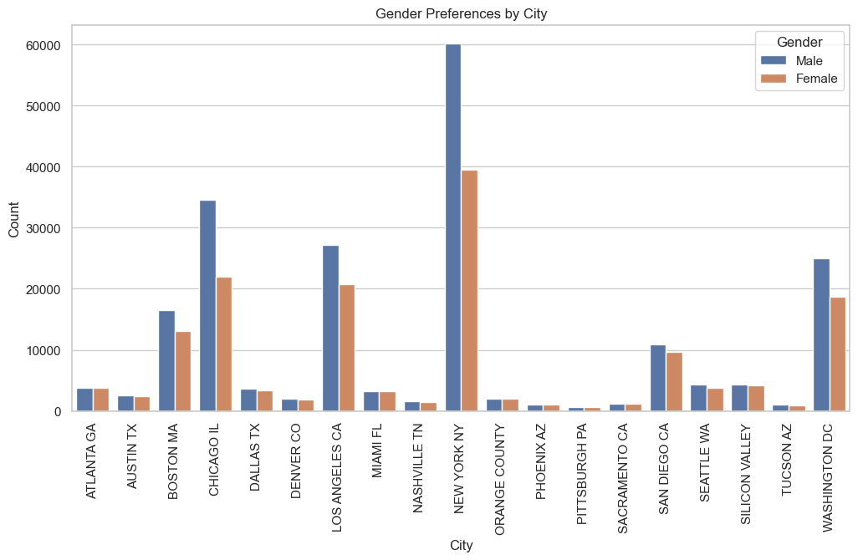
Hypothesis 3: "Do cab users' gender preferences vary by city?"
There is a significant variation in the gender preferences of cab users across cities.
This suggests that cab companies may want to consider the gender preferences of cab users in different cities when developing their marketing and operational strategies.

Slide 20
Conclusion
Key Findings
Market Share: Yellow Cab has a higher market share than Pink Cab in all cities except for San Diego and Tucson. Yellow Cab's market share has been growing over time, while Pink Cab's market share has been declining.
Profitability: Yellow Cab's average profit per KM is higher than Pink Cab's average profit per KM.
Seasonality: There is a seasonal trend in the number of cab users, with the number of users being higher in the summer months and lower in the winter months.
Population size: There is a positive correlation between population size and the number of cab users.
Gender preferences: Cab users' gender preferences vary by city.
Recommendations
Yellow Cab: Continue to focus on growing its market share and maintaining its dominance in the taxi industry.
Pink Cab: Focus on improving its services and offerings to compete more effectively with Yellow Cab. Pink Cab may also want to consider niche markets where it can compete more effectively.
Based on the analysis I have done, I would recommend Yellow Cab for investment.

Slide 21
Thank You

